Slide 1
Power System Operation

Slide 2
Introduction
Electricity markets rely on the power system infrastructure
Participants have no choice to use a different system
Cost to consumers of outages is very high
Consumers have expectations for continuity of service
Avoiding outages requires an awareness of the whole system
System operator is responsible for avoiding outages

Slide 3
Reliability
Public good:
  All participants benefit from it without subtracting from the reliability that other get
System operator not liable for outages
Generators and customers bear the cost of outages
Regulator sets reliability standards
  Planning standards
  Operating standards

Slide 4
Value of reliability
Cost of outages is a function of the value that customers put on reliability
Depends on:
  Duration of outage
  Time of outage
  Customer
    Type: residential, commercial, industrial
    Individual customer
Cost of outages is much greater to consumers than to producers

Slide 5
Value of Lost Load (VoLL)
Value that an average customer puts on not consuming a kWh because of an unplanned outage
Measured in $/kWh
Grossly oversimplifies the issue
Nevertheless useful information
Usually determined using surveys

Slide 6
Value of Lost Load (VoLL)
Country/Region | VoLL ($/MWh) | Source
United Kingdom | $22,000 | London Economics
Countries of the European Union | $12,290 - $29,050 | European Commission
United States | $7,500 | Brattle Group
MISO | $3,500 | MISO
New Zealand | $41,269 | London Economics
Victoria - Australia | $44,438 | London Economics
Australia | $45,708 | London Economics
Ireland | $9,538 | London Economics
Northeast USA | $9,283-$13,925 | London Economics

Slide 7
Cost of reliability
Investment cost
  Build facilities to avoid outages (chapter 7 & 8)
Operating cost
  Cost of measures required to reduce the risk of outages
  Preventive actions
  Corrective actions

Slide 8
Cost of reliability
System must be able to operate continuously if situation does not change
System must remain stable for common contingencies
  Fault on a transmission line or other component
  Sudden failure of a generating unit
  Rapid change in load
System operator must consider consequences of contingencies

Slide 9
Preventive actions
Put the system in a state such that it will remain stable if a contingency does occur
Operate the system at less than full capacity
Examples:
  Limit the commercial transactions that are allowed in bilateral markets
  Market clearing based on OPF in centralized markets

Slide 10
Corrective actions
Taken only if a disturbance does occur
Limit the consequences of this disturbance
Need resources that belong to market participants
Ancillary services or reliability resources that must be purchased from the market participants by the system operator
When called, some ancillary services will deliver some energy
However, capacity to deliver is the important factor
Remuneration on the basis of availability, not energy

Slide 11
How much reliability?
Ideally:
  marginal value of reliability = marginal cost of reliability
Finding this equilibrium is very difficult:
  Probabilistic calculation
  Vast number of possible outages
  Major concern is cascading outages
  How to deal with an outage depends on the state of the system
  Reliability resources can be used for various purposes

Slide 12
How much reliability?
In practice:
  Deterministic rules defined by the regulator
    In essence, the regulator buys reliability on behalf of all the consumers
  Define “credible outages”
    Outages that the system should be able to withstand without load disconnections
    Typically outage of a single component
    Simultaneous outage of two components is assumed to have a very low probability
  System operator is required to consider only these credible outages

Slide 13
Procuring reliability resources
How close to real time?
Long term contracts for ancillary services:
  Reduces risk
  Amount available not linked to state of the system
Short term market
  More closely linked to the needs
  Increased risk of not having enough

Slide 14
Outline
Describe the needs for ancillary services
  Keeping the generation and load in balance
  Keeping the security of the transmission network
Obtaining ancillary services
  How much ancillary services should be bought?
  How should these services be obtained?
  Who should pay for these services?
Selling ancillary services
  Maximize profit from the sale of energy and ancillary services

Slide 15
Operational Issues

Slide 16
Impact of a failure
A
B
Load
If both generators are rated at 100MW, the maximum load that they
can reliably supply together is 100MW

Slide 17
Balancing production and consumption
Assume that all generators, loads and tie-lines are connected to the same bus
Only system variables are total generation, total load and net interchange with other systems
Generation
Load
Interchanges

Slide 18
Balancing production and consumption
If production = consumption, frequency remains constant
In practice:
  Constant fluctuations in the load
  Inaccurate control of the generation
  Sudden outages of generators and interconnectors
Excess load causes a drop in frequency
Excess generation causes an increase in frequency

Slide 19
Balancing production and consumption
Generators can only operate within a narrow range of frequencies
  Protection system disconnects generators when frequency is too high or too low
  Causes further imbalance between load and generation
System operator must maintain the frequency within limits

Slide 20
Balancing production and consumption
Rate of change in frequency inversely proportional to the total inertia of generators and rotating loads
Frequency changes are much smaller in large interconnected systems than in small isolated systems

Slide 21
Balancing production and consumption
Local imbalance in an interconnected system causes a change in tie-line flows
Inadvertent flows can overload the tie-lines
Protection system may disconnect these lines
Could lead to further imbalance between load and generation
Each system must remain in balance
Inadvertent flow

Slide 22
Balancing production and consumption
Minor frequency deviations and inadvertent flows are not an immediate threat
However, they weaken the system
Must be corrected quickly so the system can withstand further problems

Slide 23
Example: load over 5 periods
300
Load [MW]
250
200
150
100
50
0
1
2
3
4
5
Period

Slide 24
Energy traded based on forecast
300
Load [MW]
250
200
150
100
50
0
1
2
3
4
5
Period

Slide 25
Energy produced vs. energy traded
300
Load [MW]
250
200
150
100
50
0
1
2
3
4
5
Period

Slide 26
Imbalance
100
Imbalance [MW]
50
0
-50
-100
-150
1
2
3
4
5
Period
Notes:
Fig. 5.2: (A): Typical load and generation fluctuations over five market periods. (B) Imbalances resulting from these fluctuations.

Slide 27
Components of the imbalance
100
Random load fluctuations
Imbalance [MW]
50
0
-50
Slower load
fluctuations
Outage
-100
-150
1
2
3
4
5
Period
Notes:
Fig. 5.2: (A): Typical load and generation fluctuations over five market periods. (B) Imbalances resulting from these fluctuations.

Slide 28
Example (continued)
Differences between load and energy traded:
  Trades do not track rapid load fluctuations
    Market assumes load constant over trading period
  Error in forecast
Differences between energy traded and energy produced
  Minor errors in control
  Finite ramp rate at the ends of the periods
  Unit outage creates a large imbalance

Slide 29
Balancing services
Different phenomena contribute to imbalances
Each phenomenon has a different time signature
Different services are required to handle these phenomena
Exact definition differ from market to market

Slide 30
Regulation service
Designed to handle:
  Rapid fluctuations in load
  Small, unintended variations in generation
Designed to maintain:
  Frequency close to nominal
  Interchanges at desired values
Provided by generating units that:
  Can adjust output quickly
  Are connected to the grid
  Are equipped with a governor and usually are on AGC
  (Automatic Generation Control)

Slide 31
Load following service
Designed to handle intra-period load fluctuations
Designed to maintain:
  Frequency close to nominal
  Interchanges at desired values
Provided by generating units that can respond at a sufficient rate

Slide 32
Contingency reserve
Must handle large deficits caused by outages of generators or tie-lines
Classification:
  Spinning reserve
    Primary response:
      Quick but not sustainable
      Stop the decline in frequency
    Second response:
      slower but sustainable
      Restore frequency to nominal value
  Non-spinning reserve
    Requires 10-15 minutes to come on line
    Designed to replace the spinning reserve

Slide 33
Example: Outage of large generating unit
Gas turbines
Secondary response
Primary response

Slide 34
Classification of balancing services
Regulation and load following services:
  Almost continuous action
  Relatively small
  Quite predictable
  Preventive security actions
Reserve services:
  Use is unpredictable
  Corrective security actions
  Provision of reserve is a form of preventive security action
Definition and parameters depend on the market

Slide 35
      Effect of stochastic generation
Lead Time [Hours] | Maximum Change Observed [MW]
0.5 | 1,090-1,450
1 | 2,100-2,800
2 | 4,050-5,400
4 | 7,200-9,650

Slide 36
Network issues: contingency analysis
Operator continuously performs contingency analysis
No credible contingency should destabilize the system
Modes of destabilization:
  Thermal overload
  Transient instability
  Voltage instability
If a contingency could destabilize the system, the operator must take preventive action

Slide 37
Types of preventive actions
Low cost preventive actions:
  Examples
    Adjust taps of transformers
    Adjust reference voltage of generators
    Adjust phase shifters
  Effective but limited
High cost preventive actions:
  Restrict flows on some branches
  Requires limiting the output of some generating units
  Affect the ability of some producers to trade on the market

Slide 38
Example: thermal capacity
A
B
Load
Each line between A and B is rated at 200 MW
Generator at A can sell only 200 MW to load at B
Remaining 200 MW must be kept in reserve in case of outage of one of the lines

Slide 39
Example: emergency thermal capacity
A
B
Load
Each line between A and B is rated at 200 MW
Each line has a 10% emergency rating for 20 minutes
If generator at B can increase its output by 20 MW in 20 minutes, the generator at A can sell 220 MW to load at B

Slide 40
Example: transient stability
A
B
Load
Assumptions:
  B is an infinite bus
  Transient reactance of A = 0.9 p.u., inertia constant H = 2 s
  Each line has a reactance of 0.3 p.u.
  Voltages are at nominal value
  Fault cleared in 100 ms by tripping affected line
Maximum power transfer: 108 MW

Slide 41
Example: voltage stability
A
B
Load
No reactive support at B
  198 MW can be transferred from A to B before the voltage at B drops below 0.95 p.u.
  However, the voltage collapses if a line is tripped when power transfer is larger than 166 MW
The maximum power transfer is thus 166 MW

Slide 42
Example: voltage stability
A
B
Load
25 MVAr of reactive support at B
  190 MW can be transferred from A to B before the outage of a line causes a voltage collapse

Slide 43
Voltage control and reactive support services
Use reactive power resources to maximize active power that can be transferred through the transmission network
Some of these resources are under the control of the system operator:
  Mechanically-switched capacitors and reactors
  Static VAr compensators
  Transformer taps
Best reactive power resources are the generators
Need to define voltage control services to specify the conditions under which the system operator can use these resources

Slide 44
Voltage control and reactive support services
Must consider both normal and abnormal conditions
Normal conditions:
  0.95 p.u. ≤ V ≤ 1.05 p.u.
Abnormal conditions:
  Provide enough reactive power to prevent a voltage collapse following an outage
Requirements for abnormal conditions are much more severe than for normal conditions
Reactive support is more important than voltage control

Slide 45
Example: voltage control under normal conditions
A
B
R=0.06 p.u.
X=0.6 p.u.
B=0.2 p.u.
B=0.2 p.u.
Load
Load at B has unity power factor
Voltage at A maintained at nominal value
Control voltage at B?

Slide 46
Example: voltage control under normal conditions
Voltage at B
Reactive injection at B

Slide 47
Example: voltage control under normal conditions
A
B
Load
Controlling the voltage at B using generator at A?
Local voltage control is much more effective
Severe market power issues in reactive support

Slide 48
Example: pre- and post-contingency balance
68 MW
65 MW
0 MW
A
B
136 MW
13 MVAr
0.6 MVAr
1.2 MVAr
Pre-contingency:
26 MVAr
1.0 p.u.
1.0 p.u.
68 MW
65 MW
130 MW
0 MVAr
13 MVAr
0.6 MVAr
A
B
0 MW
145 MW
67 MVAr
Post-contingency:
40 MVAr
1.0 p.u.
1.0 p.u.
145 MW
130 MW
130 MW
0 MVAr
40 MVAr
67 MVAr

Slide 49
Example: reactive support following line outage
A
B

Slide 50
Other ancillary services
Stability services
  Intertrip schemes
    Disconnection of generators following faults
  Power system stabilizers
Blackstart restoration capability service

Slide 51
Market models vs. operational models
Market models must be simple and robust
  Ensuring that the market clears is paramount!
Too simple to capture the complexity of operations
Operators use much more sophisticated models
Use of proxies to reflect operational limits in market clearing

Slide 52
Obtaining ancillary services

Slide 53
How should services be obtained?
Two approaches:
  Compulsory provision
  Market for ancillary services
Both have advantages and disadvantages
Choice influenced by:
  Type of service
  Nature of the power system
  History of the power system

Slide 54
Compulsory provision
To be allowed to connect to the system, generators may be obliged to meet some conditions
Examples:
  Generator must be equipped with governor with 4% droop
    All generators contribute to frequency control
  Generator must be able to operate from 0.85 lead to 0.9 lag
    All generators contribute to voltage control and reactive support

Slide 55
Advantages of compulsory provision
Minimum deviation from traditional practice
Simplicity
Usually ensures system security and quality of supply

Slide 56
Disadvantages of compulsory provision
Not necessarily good economic policy
  May provide more resources than needed and cause unnecessary investments
    Not all generating units need to help control frequency
    Not all generating units need to be equipped with a stabilizer
Discourages technological innovation
  Definition based on what generators usually provide
Generators have to provide a costly service for free
  Example: providing reactive power increases losses and reduces active power generation capacity

Slide 57
Disadvantages of compulsory provision
Equity
  How to deal with generators that cannot provide some services?
    Example: nuclear units can’t participate in frequency response
Economic efficiency
  Not a good idea to force highly efficient units to operate part-loaded to provide reserve
  More efficient to determine centrally how much reserve is needed and commit additional units to meet this reserve requirement
Compulsory provision is thus not applicable to all services
How to deal with exceptions that distort competition?

Slide 58
Market for ancillary services
Different markets for different services
Long term contracts
  For services where quantity needed does not change and availability depends on equipment characteristics
  Example: blackstart capability, intertrip schemes, power system stabilizer, frequency regulation
Spot market
  Needs change over the course of a day
  Price changes because of interactions with energy market
  Example: reserve
System operator may reduce its risk by using a combination of spot market and long term contracts

Slide 59
Advantages of market for ancillary services
More economically efficient than compulsory provision
System operator buys only the amount of service needed
Only participants that find it profitable provide services
Helps determine the true cost of services
Opens up opportunities for innovative solutions

Slide 60
Disadvantages of market for ancillary services
More complex
Probably not applicable to all types of services
Potential for abuse of market power
  Example: reactive support in remote parts of the network
  Market for reactive power would need to be carefully regulated

Slide 61
System balancing with renewables
Stochastic renewable require more reserve
Providing this reserve from conventional generation may be:
  Technically difficult or impossible
  Expensive
Provide some reserve from the demand side

Slide 62
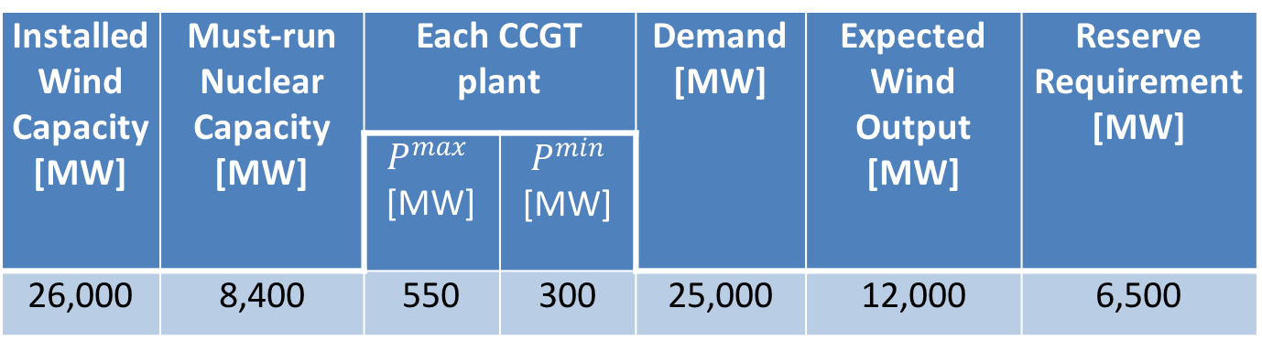
Example
Installed Wind Capacity[MW] | Must-run Nuclear Capacity [MW] | Each CCGT plant |  | Demand [MW] | Expected Wind Output [MW] | Reserve Requirement [MW]
 |  | $P^{max}$ [MW] | $P^{min}$ [MW]
26,000 | 8,400 | 550 | 300 | 25,000 | 12,000 | 6,500

Slide 63
Example
 | No reserve | CCGT reserve only | CCGT + demand reserve
Nuclear (MW) | 8,400 | 8,400 | 8,400
CCGT (MW) | 4,600 | 7,800 | 5,400
Wind (MW) | 12,000 | 12,000 | 12,000
Wind curtailment (MW) | 0 | 3,200 | 800
CO₂ emission rate (g/kWh) | 68.8 | 137.28 | 95.04
Total CO₂ emission (ton/30mins) | 860 | 1716 | 1188

Slide 64
Demand-side provision of ancillary services
Creating a market for ancillary services opens up an opportunity for the demand-side to provide ancillary services
Unfortunately, definition of ancillary services often still based on traditional practice
In a truly competitive environment, the system operator should not favor any participant, either from the supply- or demand-side

Slide 65
Advantages of demand-side provision
Larger number of participants increases competition and lowers cost
Better utilization of resources
  Example:
    Providing reserve with interruptible loads rather than partly loaded thermal generating units
    Particularly important if proportion of generation from renewable sources increases
Demand-side may be a more reliable provider
  Large number of small demand-side providers

Slide 66
Opportunities for demand-side provision
Different types of reserve
  Interruptible loads
Frequency regulation
  Variable speed pumping loads

Slide 67
How much ancillary services should be bought?
System Operator purchases the services
  Works on behalf of the users of the system
Services are used mostly for contingencies
  Availability is more important than actual usage
Not enough services
  Can’t ensure the security of the system
  Can’t maintain the quality of the supply
Too much services
  Life of the operator is easy
  Cost passed on to system users

Slide 68
How much ancillary services should be bought?
System Operator must perform a cost/benefit analysis
  Balance value of services against their cost
Value of services: improvement in security and service quality
Complicated probabilistic optimization problem
Should give a financial incentive to the operator to acquire the right amount of services at minimum cost

Slide 69
Co-optimization of energy & reserve
Early energy markets:
  Sequential market clearing
    Market for fastest type of reserve
    Market for slower type of reserve
    Energy market
  Unsuccessful bids are considered in subsequent markets
Led to problems and gaming of rules

Slide 70
Co-optimization of energy & reserve
Interactions between energy and reserve
  Providing reserve means providing less energy
  More expensive generators have to produce energy
  Partly-loaded generators that provide reserve operate less efficiently and may need compensation
Centralized markets need simultaneous clearing of energy and reserve
  Must make sure that no participant is disadvantaged

Slide 71
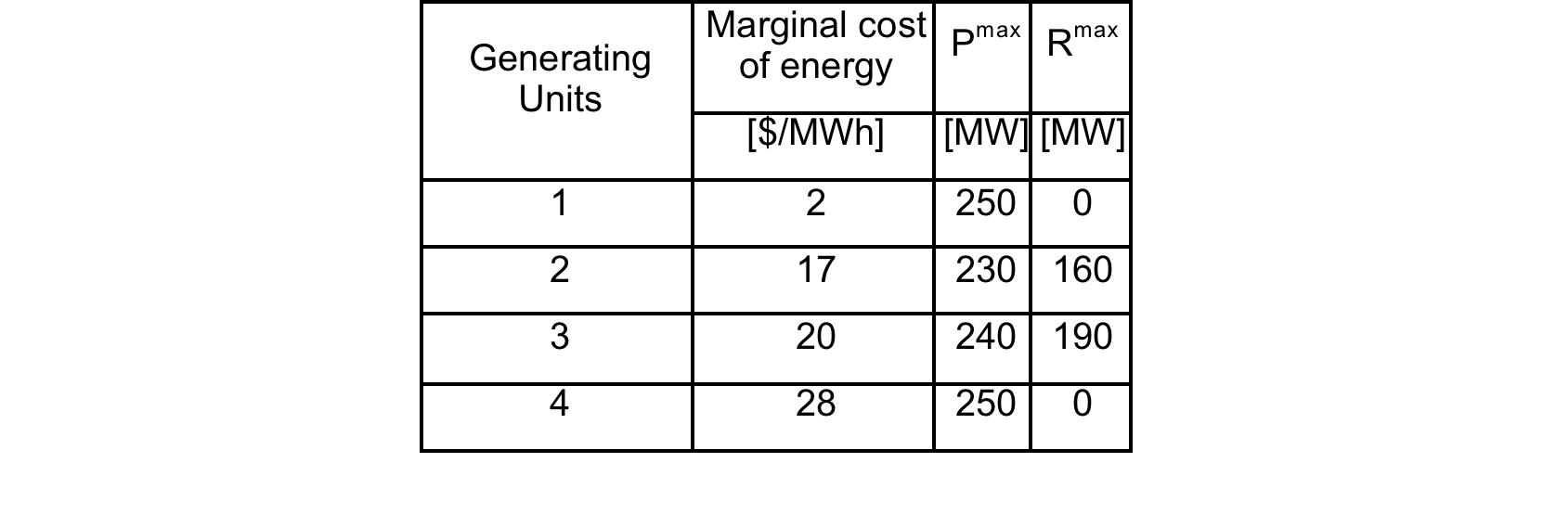
Example
Constant marginal costs
Units 2 & 3 can provide reserve
Units 1 & 4 cannot provide reserve
Ignore P^{min} and startup costs for simplicity

Slide 72
Ability to provide reserve
Reserve
Capacity
[MW]
Reserve
Capacity
[MW]
Unit 2
190
Unit 3
160
70
230
Energy
Produced
[MW]
50
240
Energy
Produced
[MW]
Limited by
ramping
Limited by
headroom
Limited by
ramping
Limited by
headroom

Slide 73
Assumptions about the market
Perfectly competitive
Generators submit bids for energy only
Market/System operator dispatches generation to meet the load at minimum cost while providing the reserve needed
  Constant reserve requirement: 250 MW
  Load varies between 300 MW and 720 MW

Slide 74
Formulation of the optimization problem
Decision variables
  Power produced by the generators:
  Reserve provided by the generators:
Objective function:
Constraints
  Load generation balance:
  Minimum reserve requirement:
  Limits on generating units:

Slide 75
Formulation of the optimization problem
Limits on the reserve capabilities of the generating units:
Limits on the capacity of the generating units:

Slide 76
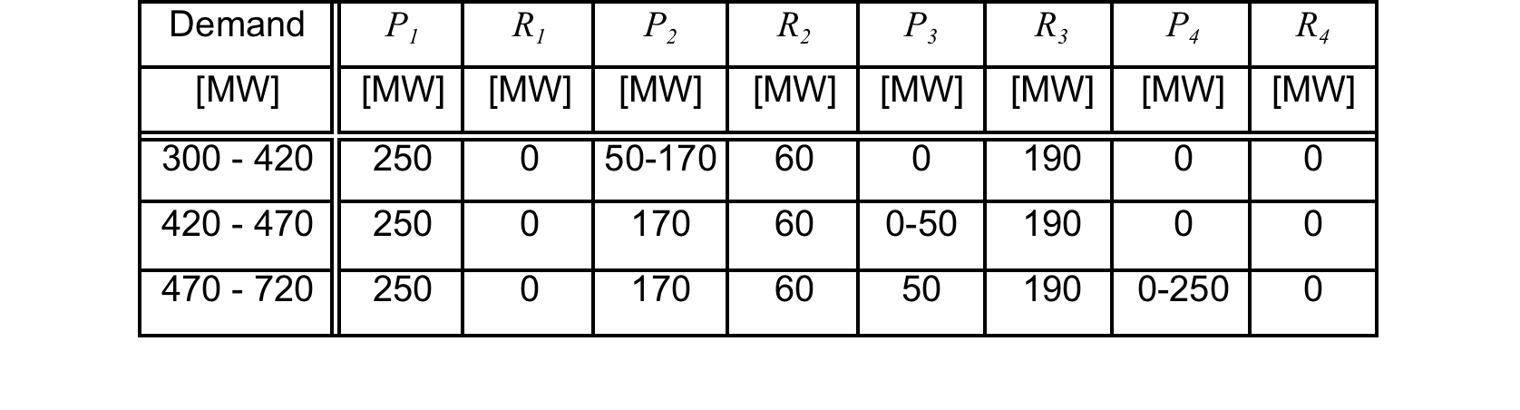
Solution of the co-optimization problem
Linear programming problem
Lagrange multipliers of the constraints
  Load/generation balance → price of energy
  Reserve requirement → price of reserve

Slide 77
Solution “by hand”
Unit 1 is the cheapest → produces 250 MW
Units 2 & 3 are needed for reserve

Slide 78
300MW – 420MW range
Unit 1 produces 250 MW
Unit 2 is the marginal unit
  Production increases from 50 MW to 170 MW
  Sets the marginal price for energy at 17$/MWh
Units 2 & 3 provide more than enough reserve
  Price of reserve is zero

Slide 79
420MW – 470 MW range
Unit 2 is capped at 170 MW because it must provide 60 MW of reserve
Unit 3 is the marginal unit
  Production increases from 0 to 50 MW
  Sets the marginal price for energy at 20$/MWh
Price of reserve = cost of an additional MW of reserve beyond 250 MW
  Unit 3 provides its maximum reserve of 190 MW
  To get one more MW of reserve, must reduce output of unit 2 by 1 MW and increase output of unit 3 by 1 MW
  Price of reserve = 20 – 17 = 3 $/MWh

Slide 80
470MW – 720 MW range
Unit 4 is the marginal unit
  Increases production from 0 to 250 MW
  Price of energy is 28 $/MWh
Reserve constraint limits production of units 2 & 3 at 170 MW and 50 MW respectively
To get one additional MW of reserve we need to
  Reduce output of unit 2 by 1 MW
  Increase output of unit 4 by 1 MW
  Price of reserve = 28 – 17 = 11 $/MWh

Slide 81
Summary of prices

Slide 82
Profitability of unit 2: 300MW – 420MW range
Marginal unit for energy → no profit
Price of reserve is zero → no profit

Slide 83
Profitability of unit 2: 420 MW – 470 MW range
Output of unit 2 is capped by reserve requirement
Unit 3 is marginal unit
Energy price is 20 $/MWh
Reserve price is 3 $/MWh
Marginal cost of unit 2 is 17 $/MW
Unit 2 gets its opportunity cost for every MW of reserve
It is thus not penalized for providing reserve

Slide 84
Profitability of unit 2: 470 MW – 720 MW range
Unit 4 is the marginal unit
Energy price is 28 $/MWh
Profit of 11 $/MWh for its energy production
Reserve price is 11 $/MWh
Again, revenue from reserve is equal to opportunity cost because unit 2 is marginal for reserve
Unit 2 is indifferent to producing energy or reserve
Unit 3 makes a profit on energy and reserve because it is marginal for neither

Slide 85
Profitability of unit 2

Slide 86
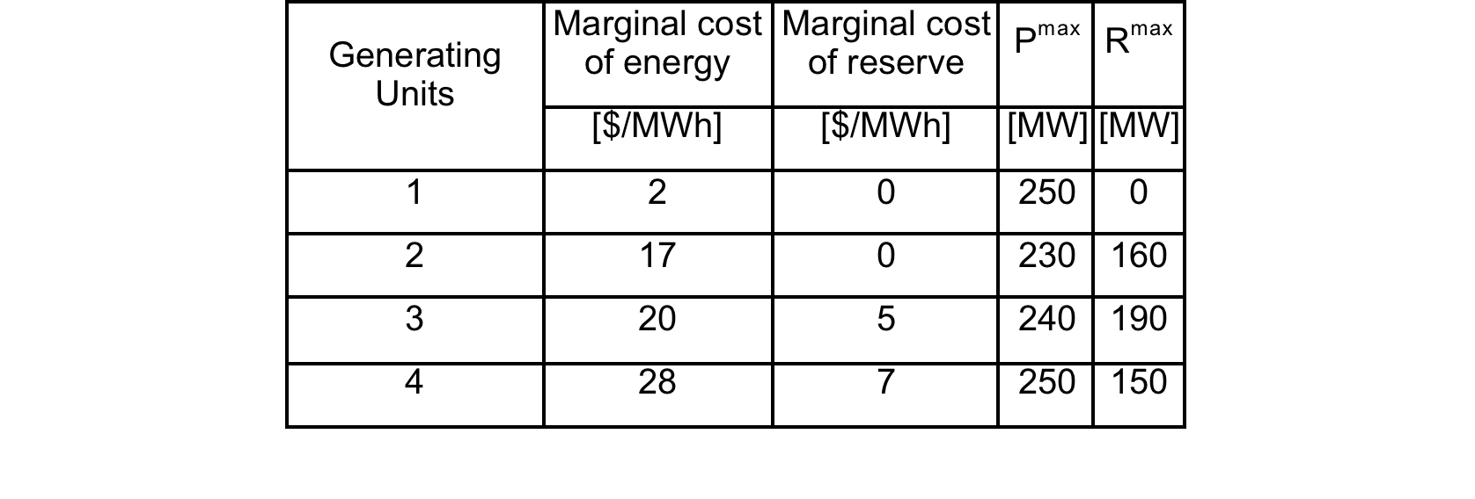
Another example
Assume that the market rules allow units to bid separately for energy and reserve
Bid for reserve may reflect loss of efficiency or additional maintenance requirements
Objective function:

Slide 87
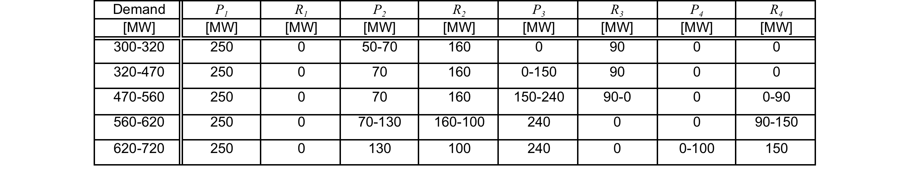
Solution
See textbook for detailed discussion
Co-optimization achieves:
  Cost minimization
  Fair treatment of generators
  Satisfaction of security constraints

Slide 88





    Allocation of transmission capacity between energy and reserve
$$π_{B}^{E}=10+0.01P_{B}+0.001R_{B}$$
$$π_{B}^{R}=1+0.001R_{B}+0.001P_{B}$$
$$π_{S}^{E}=13+0.02P_{S}+0.001R_{S}$$
$$π_{S}^{R}=5+0.019R_{S}+0.001P_{S}$$
$$Min\left\{C_{B}\left(P_{B},R_{B}\right)+C_{S}\left(P_{S},R_{S}\right)\right\}$$

Slide 89






    Allocation of transmission capacity between energy and reserve
$$Min\left\{C_{B}\left(P_{B},R_{B}\right)+C_{S}\left(P_{S},R_{S}\right)\right\}$$
$$C_{B}\left(P_{B},R_{B}\right)=10P_{B} +\frac{0.01}{2}{P_{B}}^{2} + R_{B} +\frac{0.001}{2}{R_{B}}^{2} + 0.001P_{B}R_{B}$$
$$C_{S}\left(P_{S},R_{S}\right)=13P_{S} +\frac{0.02}{2}{P_{S}}^{2} + {5R}_{S} +\frac{0.019}{2}{R_{S}}^{2} + 0.001P_{B}R_{B}$$
$P_{B}−F^{E}=500$ ($π_{B}^{E})$
$P_{S}+F^{E}=2500−1000$ ($π_{S}^{E})$
$R_{B}−F^{R}=R_{B}^{R}$ ($π_{B}^{R})$
$R_{S}+F^{R}=R_{S}^{R}$ ($π_{S}^{R})$
${F^{E}+F}^{R}≤800$ ($π^{T})$

Slide 90
    Allocation of transmission capacity between energy and reserve
Optimal operation of the Borduria-Syldavia system when no transmission capacity is allocated to the sharing of reserve

Slide 91
    Allocation of transmission capacity between energy and reserve
Optimal operation of the Borduria-Syldavia system when the transmission
capacity is optimally allocated between the transfer or energy and the sharing
of reserve.

Slide 92
    Allocation of transmission capacity between energy and reserve

Slide 93
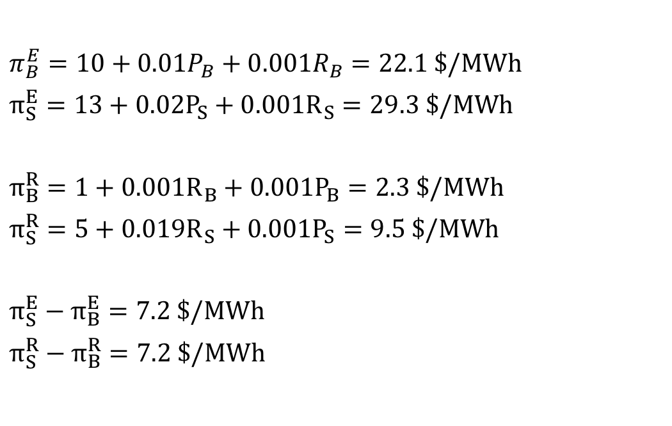
    Allocation of transmission capacity between energy and reserve
$π_{B}^{E}=10+0.01P_{B}+0.001R_{B}=22.1 \$/MWh$
$π_{S}^{E}=13+0.02P_{S}+0.001R_{S}=29.3 \$/MWh$
$π_{B}^{R}=1+0.001R_{B}+0.001P_{B}=2.3 \$/MWh$
$π_{S}^{R}=5+0.019R_{S}+0.001P_{S}=9.5 \$/MWh$
$π_{S}^{E}−π_{B}^{E}=7.2 \$/MWh$
$π_{S}^{R}−π_{B}^{R}=7.2 \$/MWh$

Slide 94
Who should pay for reliability?
Not all users value security and quality of supply equally
  Examples:
    Producers vs. consumers
    Semi-conductor manufacturing vs. irrigation load
Ideally, users who value reliability more should get more security and pay for it
With the current technology, this is not possible
  System operator provides an average level of reliability to all users
  The cost of operational reliability is shared by all users on the basis of their energy consumption

Slide 95
Who should pay for reliability?
Sharing the cost of ancillary services on the basis of energy is not economically efficient
Some participants increase the need for services more than others
These participants should pay a larger share of the cost to encourage them to change their behaviour
Example: allocating the cost of reserve

Slide 96
Who should pay for reserve?
Reserve prevents collapse of the system when there is a large imbalance between load and generation
Large imbalances usually occur because of failure of generating units
Owners of large generating units that fail frequently should pay a larger proportion of the cost of reserve
Encourage them to improve the reliability of their units
In the long term:
  Reduce the need for reserve
  Reduce the overall cost of reserve

Slide 97
Selling ancillary services

Slide 98
Selling ancillary services
Ancillary services are another business opportunity for generators
Limitations:
  Technical characteristics of the generating units
    Maximum ramp rate
    Reactive capability curve
  Opportunity cost
    Can’t sell as much energy when selling reserve
    Need to optimize jointly the sale of energy and reserve

Slide 99
Example: selling both energy and reserve
Generator tries to maximize the profit it makes from the sale of energy and reserve
Assumptions:
  Consider only one type of reserve service
  Perfectly competitive energy and reserve markets
    Generator is a price-taker in both markets
    Generator can sell any quantity it chooses on either market
  Consider one generating unit over one hour
    Don’t need to consider start-up cost, min up time, min down time
  No special payments for exercising reserve

Slide 100
Notations
Market price for electrical energy ($/MWh)
Market price for reserve ($/MW/h)
Quantity of energy bid and sold
Quantity of reserve bid and sold
Minimum power output
Maximum power output
Upper limit on the reserve (ramp rate x delivery time)
Cost of producing energy
Cost of providing reserve (not opportunity cost)

Slide 101
Formulation
Objective function:
Constraints:
(We assume that
)
Lagrangian function:

Slide 102
Optimality conditions

Slide 103
Complementary slackness conditions

Slide 104
Case 1:
No binding constraints
Provide energy and reserve up to the point where marginal cost is equal to price
No interactions between energy and reserve

Slide 105
Case 2:
Generation capacity fully utilized by energy and reserve:
Marginal profit on energy equal to marginal profit on reserve

Slide 106
Case 3:
Unit operates at minimum stable generation
Marginal profit on reserve
Marginal loss on energy minimized by operating at minimum
KKT conditions guarantee only marginal profitability, not actual profit

Slide 107
Cases 4 & 5:
Since we assume that these cases are not interesting
because the upper and lower limits cannot be binding at the same time

Slide 108
Case 6:
Reserve limited by ramp rate
Maximum profit on energy
Profit on reserve could be increased if ramp rate constraint could be relaxed

Slide 109
Case 7:
Maximum capacity and ramp rate constraints are binding
Sale of energy and sale of reserve are both profitable
Sale of reserve is more profitable but limited by the ramp rate constraint

Slide 110
Case 8:
Generator at minimum output and reserve limited by ramp rate
Sale of reserve is profitable but limited by ramp rate constraint
Sale of energy is unprofitable
Overall profitability needs to be checked

